Slide 1
Chapter 1 Introduction to published accounts
This chapter covers the following
IAS Preparation of financial statements of companies
Statement of financial position
Statement of changes in equity
Statement of profit or loss and other comprehensive income
Introduction to published accounts

Slide 2
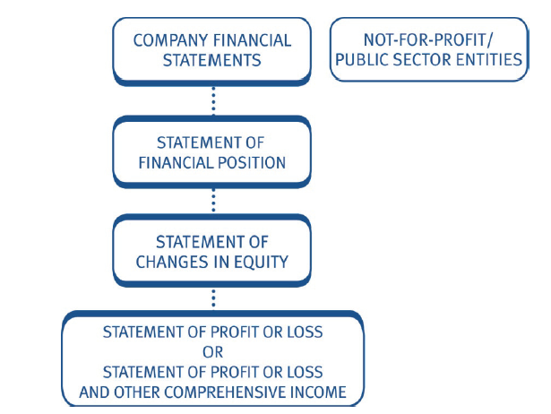

Slide 3
1 IAS 1 Preparation of Financial Statements of companies
IAS 1 – Presentation of Published Financial Statements
Provides formats to prepare Financial statements
Statement of P or L and other comprehensive income
Accounting policies and explanatory notes
Statement of Financial Position
Statement of Changes in equity
Statement of Cash flow

Slide 4
Exceptional items
These are material items of income and expenses of such size, nature or incidence which needs disclosure to explain the performance
Accounting treatment
Include in the standard format of P or L as separate line
Disclose the nature and amount in the notes
Examples
Written down of inventories to NRV
Impairment of PPE
Restructuring costs
Gain or loss of disposal of PPE
Discontinued operations
Litigation settlements
Reversals of provisions

Slide 5
Statement of Financial Position
Noncurrent assets
Property plant and equipment xx
Investments xx
Intangibles xx
Total Non current assets xx
Current assets
Inventory xx
Trade receivables xx
Prepayments xx
Cash and Bank deposits xx
Assets held for sale xx
Total Current Assets xx
Total Assets xx
Equity and Capital
Capital and reserves
Ordinary shares of $1 each xx
Retained earnings xx
Other components of equity xx
Total Equity xx
Noncurrent liabilities
10% loan notes (long term loans xx
Deferred tax xx xx
Current liabilities
Trade payables xx
Short term borrowings xx
Short term provisions xx
Income tax liability xx xx
Total capital and liabilities xx
Other components of equity includes
Revaluation surplus
Share premium
Investment reserve

Slide 6
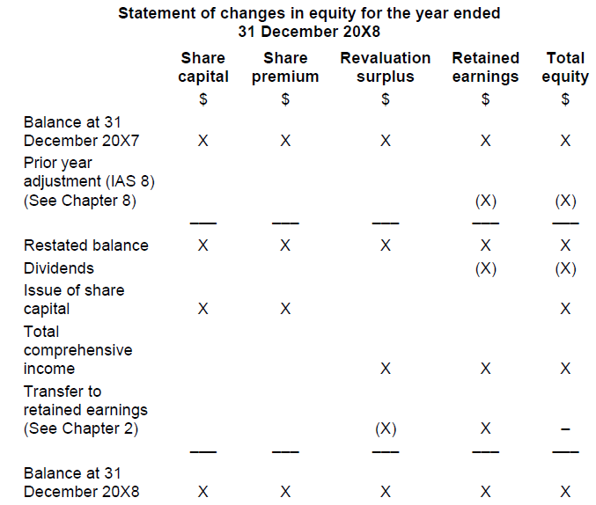

Slide 7
Statement of profit or loss and other comprehensive income
Revenue xx
Cost of sales (xx)
——
Gross profit xx
Administrative expenses (x)
Distribution costs – (x)
——
Operating profit xxx
Investment income x
Finance cost (xx)
——
Profit before tax xxx
Income tax expense (xx)
——
Profit for the period xxx
Other comprehensive income:
Surplus on property revaluation in the year xx
gain or loss on FV through other comp. income xx
——
Total comprehensive income for the year xxx

Slide 8
2. Introduction to published accounts:

